Slide 1
Housing: Price Prediction Project
Mehul Sonthalia

Slide 2
INDEX
(i) Problem Statement
(ii) EDA Steps
(iii) Feature Engineering & Visualization
(iv) Important Steps
(v) Model Dashboard
(vi) Finalized Model
(vii) Conclusion

Slide 3
(i) Problem Statement
Problem Statement:
Houses are one of the necessary need of each and every person around the globe and therefore housing and real estate market is one of the markets which is one of the major contributors in the world’s economy. It is a very large market and there are various companies working in the domain. Data science comes as a very important tool to solve problems in the domain to help the companies increase their overall revenue, profits, improving their marketing strategies and focusing on changing trends in house sales and purchases. Predictive modelling, Market mix modelling, recommendation systems are some of the machine learning techniques used for achieving the business goals for housing companies. Our problem is related to one such housing company.
A US-based housing company named Surprise Housing has decided to enter the Australian market. The company uses data analytics to purchase houses at a price below their actual values and flip them at a higher price. For the same purpose, the company has collected a data set from the sale of houses in Australia. The data is provided in the CSV file below.
The company is looking at prospective properties to buy houses to enter the market. You are required to build a model using Machine Learning in order to predict the actual value of the prospective properties and decide whether to invest in them or not. For this company wants to know:
• Which variables are important to predict the price of variable?
• How do these variables describe the price of the house?

Slide 4
Problem Statement
Business Goal:
You are required to model the price of houses with the available independent variables. This model will then be used by the management to understand how exactly the prices vary with the variables. They can accordingly manipulate the strategy of the firm and concentrate on areas that will yield high returns. Further, the model will be a good way for the management to understand the pricing dynamics of a new market.

Slide 5
(ii) EDA STEPS
1. Import libraries and load dataset
2. Dataset Exploration
3. Drop Unnecessary Columns & Rows
4. Treating Null Values
5. Imputation
6. Encoding
7. Check Correlation

Slide 6
1. Import Libraries & Load Dataset
import pandas as pd
import numpy as np
from sklearn.linear_model import LinearRegression
from sklearn.linear_model import LogisticRegression
from sklearn.tree import DecisionTreeRegressor
from sklearn.preprocessing import StandardScaler
from sklearn.model_selection import train_test_split,cross_val_score,GridSearchCV
from sklearn.feature_selection import SelectKBest,f_classif
import seaborn as sns
import matplotlib.pyplot as plt
import pickle
import warnings
warnings.filterwarnings('ignore')
df = pd.read_csv(r'train_house.csv')

Slide 7
2. Dataset Exploration
for i in df.columns:
print("*******************************************************")
print("Value counts of", i, "\n" )
print("DataType:-",df[i].dtypes)
if df[i].dtypes == 'object':
print("Categorical Variable")
else:
print("Numerical Variable")
print(df[i].value_counts())
print("Null Values:-",df[i].isnull().sum())
try:
print("Range:-",df[i].min(),"TO",df[i].max())
except:
pass
print('*******************************************************')

Slide 8
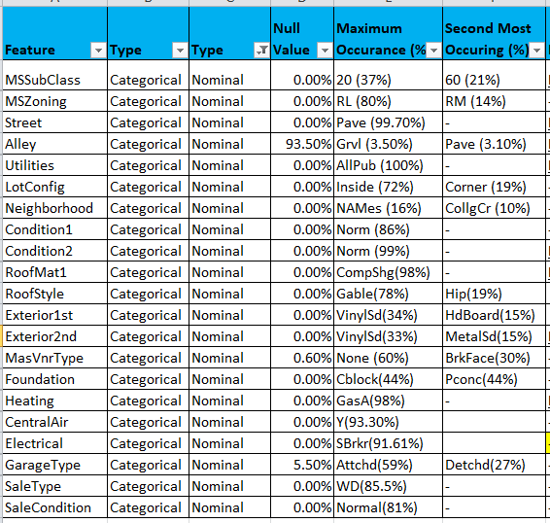
Categorical Variables (Nominal)

Slide 9
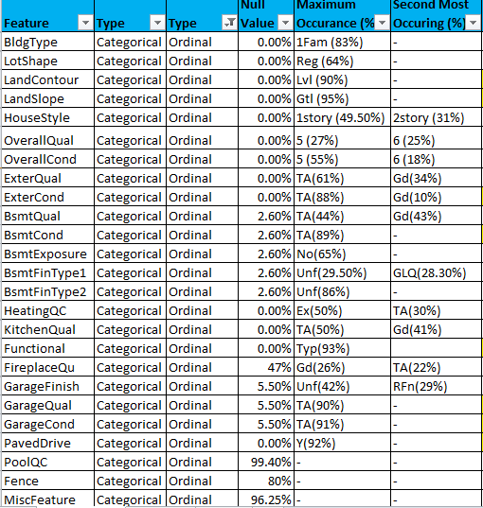
Categorical Variables (Ordinal)

Slide 10
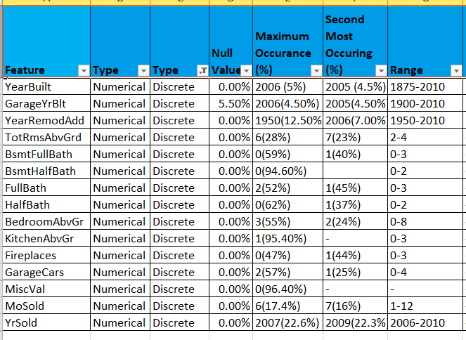
Numerical Variables (Discrete)

Slide 11
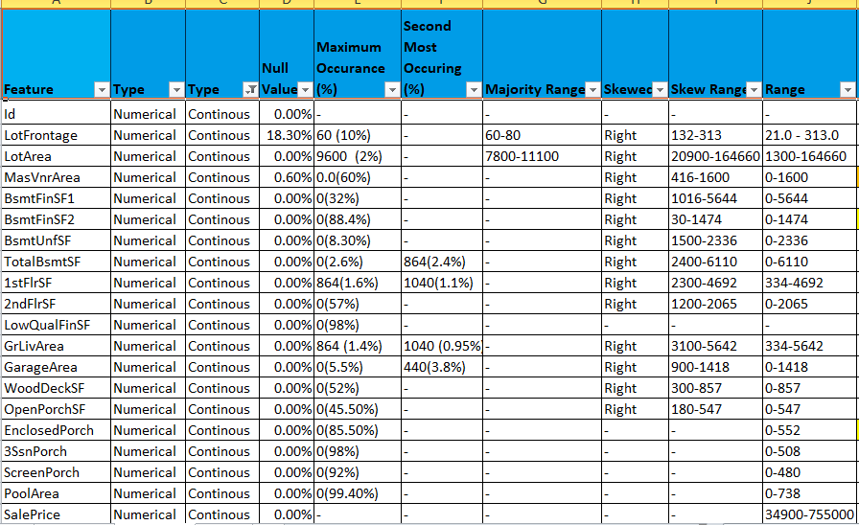
Numerical Variable (Continuous)

Slide 12
3. Drop Unnecessary Columns & Rows
We shall drop the above mentioned features who either have 80-100% null values, or above 80% a single value
drop_columns= ['Id','LowQualFinSF','3SsnPorch','ScreenPorch','PoolArea','MiscVal','PoolQC','Fence','MiscFeature','Heating','RoofMatl','Condition2','Utilities','Street','Alley']
df.drop(columns = drop_columns,inplace=True)

Slide 13
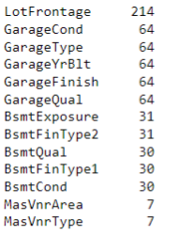
4. Treating Null Values
df.isnull().sum().sort_values(ascending=False)

Slide 14
Treating Null Values (FireplaceQu)
The most number of null values is in FireplaceQu feature
That is because in all the 551 (47%) entries, the no of fire places as per the feature Fireplaces=0
The quality of a fireplace cannot be filled when there is no fireplace present
We cannot impute any other value as the FireplaceQu, where there is no fireplace present
Hence, in order to not misguide the algorithm with a value; We shall drop the feature FireplaceQu
df.drop(columns = 'FireplaceQu' ,inplace=True)

Slide 15
Treating Null Values (Garage)
As we can see from above, all the features related to garage have 64 null entries each
Hence, lets check whether all these 64 entries are falling in the same locations or not
df[df['GarageCond'].isnull() & df['GarageType'].isnull() & df['GarageYrBlt'].isnull() & df['GarageFinish'].isnull() & df['GarageQual'].isnull()]
There are 64 rows where all of these 5 features are null at the same time hence there is no point in filling null values for any of these rows
To avoid adding arbitary values for the above rows, we shall drop them
df.drop(df.index[df['GarageCond'].isnull() & df['GarageType'].isnull() & df['GarageYrBlt'].isnull() & df['GarageFinish'].isnull() & df['GarageQual'].isnull()], inplace=True)

Slide 16
Treating Null Values (Basement)
As we can see from above, all the features related to basement have atleast 24 null entries each
Hence, lets check whether all these 24 entries are falling in the same locations or not
df[df['BsmtExposure'].isnull() & df['BsmtFinType2'].isnull() & df['BsmtQual'].isnull() & df['BsmtCond'].isnull() & df['BsmtFinType1'].isnull()]
There are 24 rows where all of these 5 features are null at the same time hence there is no point in filling null values for any of these rows
To avoid adding arbitary values for the above rows, we shall drop them
df.drop(df.index[df['BsmtExposure'].isnull() & df['BsmtFinType2'].isnull() & df['BsmtQual'].isnull() & df['BsmtCond'].isnull() & df['BsmtFinType1'].isnull()], inplace=True)

Slide 17
Treating Null Values (Veneer)
As we can see from above, all the features related to veneer type have 7 null entries each
Hence, lets check whether all these 7 entries are falling in the same locations or not
df[df['MasVnrType'].isnull() & df['MasVnrArea'].isnull()]
There are 7 rows where both of these features are null at the same time hence there is no point in filling null values for any of these rows
To avoid adding arbitary values for the above rows, we shall drop them
df.drop(df.index[df['MasVnrType'].isnull() & df['MasVnrArea'].isnull()], inplace=True)

Slide 18
5. Imputation
There is 1 null value in each of 'BsmtFinType2‘ & 'BsmtExposure‘, let us impute them with their mode (most frequent) using Simple Imputer
from sklearn.impute import SimpleImputer
imputer = SimpleImputer(strategy='most_frequent')
columns = ['BsmtFinType2','BsmtExposure']
for i in columns:
imputer = imputer.fit(df[[i]])
df[i] = imputer.transform(df[[i]])
df=df.reset_index()

Slide 19
Imputation (LotFrontage)
We will use Iterative imputer for LotFrontage feature as there are 200 null entries in it and iterative imputer will use regression to impute the values in it.
We shall pass LotArea as the other parameter to the imputer
from sklearn.experimental import enable_iterative_imputer
from sklearn.impute import IterativeImputer
iter_impute = IterativeImputer()
ite_imp = pd.DataFrame(np.round(iter_impute.fit_transform(df[['LotFrontage','LotArea']])),columns=['LotFrontage','LotArea'])
df[['LotFrontage','LotArea']]=ite_imp

Slide 20
6. Encoding (Nominal Variables)
1. Nominal Variables
nominal_var = ['MSZoning','LotConfig','Neighborhood','Condition1','RoofStyle','Exterior1st','Exterior2nd','MasVnrType','Foundation','CentralAir','Electrical','GarageType','SaleType','SaleCondition']
Nominal Variables will be encoded using the Label Encoder (as they do not require any particular order)
#LABEL ENCODER
from sklearn.preprocessing import LabelEncoder
le = LabelEncoder()
for i in nominal_var:
df[i] = le.fit_transform(df[i])

Slide 21
6. Encoding (Ordinal Variables)
Ordinal Variables shall be encoded using Ordinal Encoder (As they are in an order)
ORDINAL ENCODER
from sklearn.preprocessing import OrdinalEncoder
ordinal_var = ['LotShape','LandContour','LandSlope','ExterQual','ExterCond','BsmtQual','BsmtCond','BsmtFinType1','BsmtFinType2','BldgType','BsmtExposure','GarageFinish','HouseStyle','HeatingQC','KitchenQual','Functional','GarageQual','GarageCond','PavedDrive']
ord_enc=OrdinalEncoder(categories=[['IR3','IR2','IR1','Reg'],['Low','HLS','Bnk','Lvl'],['Gtl','Mod','Sev'],['Fa','TA','Gd','Ex'],['Fa','TA','Gd','Ex'],['Fa','TA','Gd','Ex'],['Po','Fa','TA','Gd'],['Unf','LwQ','Rec','BLQ','ALQ','GLQ'],['Unf','LwQ','Rec','BLQ','ALQ','GLQ'],['1Fam','2fmCon','Duplex','TwnhsE','Twnhs'],['No','Mn','Av','Gd'],['Unf','RFn','Fin'],['1Story','1.5Fin','1.5Unf','2Story','2.5Fin','2.5Unf','SFoyer','SLvl'],['Po','Fa','TA','Gd','Ex'],['Fa','TA','Gd','Ex'],['Sev','Maj2','Maj1','Mod','Min2','Min1','Typ'],['Po','Fa','TA','Gd','Ex'],['Po','Fa','TA','Gd','Ex'],['N','P','Y']])
df1=ord_enc.fit_transform(df[ordinal_var])
df[ordinal_var]=df1

Slide 22
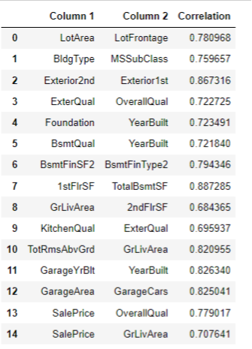
7. Check Correlation
Check Correlation using Heatmap and df.corr()

Slide 23
(iii) Feature Engineering
1. Feature Selection
2. Handling Skewness
3. Power Transformation
4. Standard Scaler

Slide 24
1. Feature Selection
Find Highly Correlated Features
Use Scatter Plot to find the relation between each feature with the Target label
Use SelectKBest Method to find the top contributing features
Drop the least contributing feature with the high correlation values

Slide 25
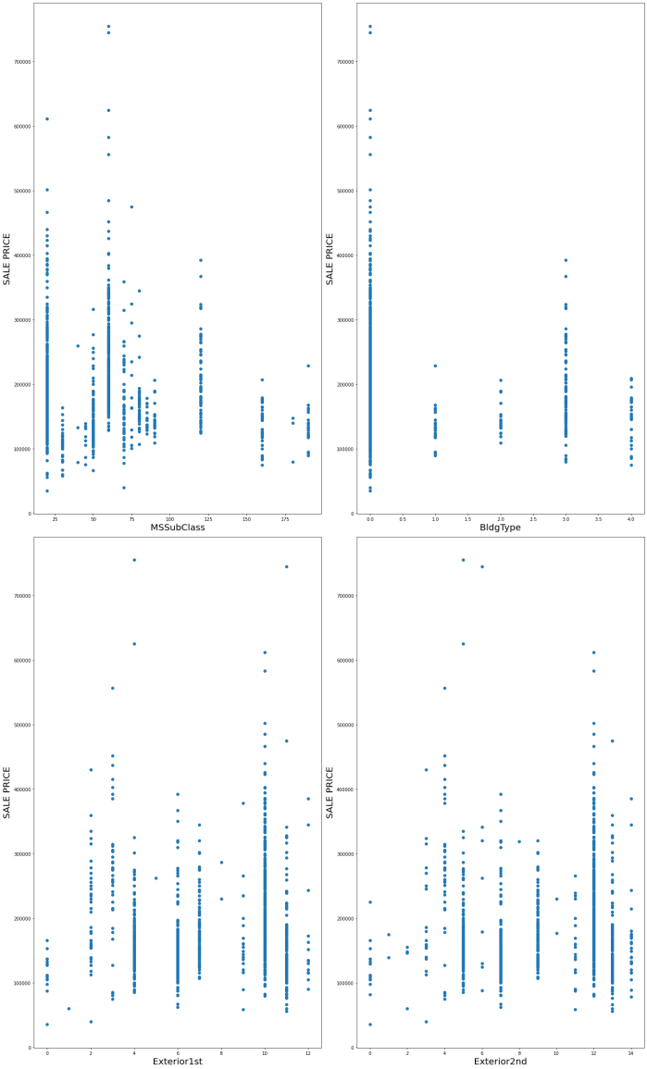
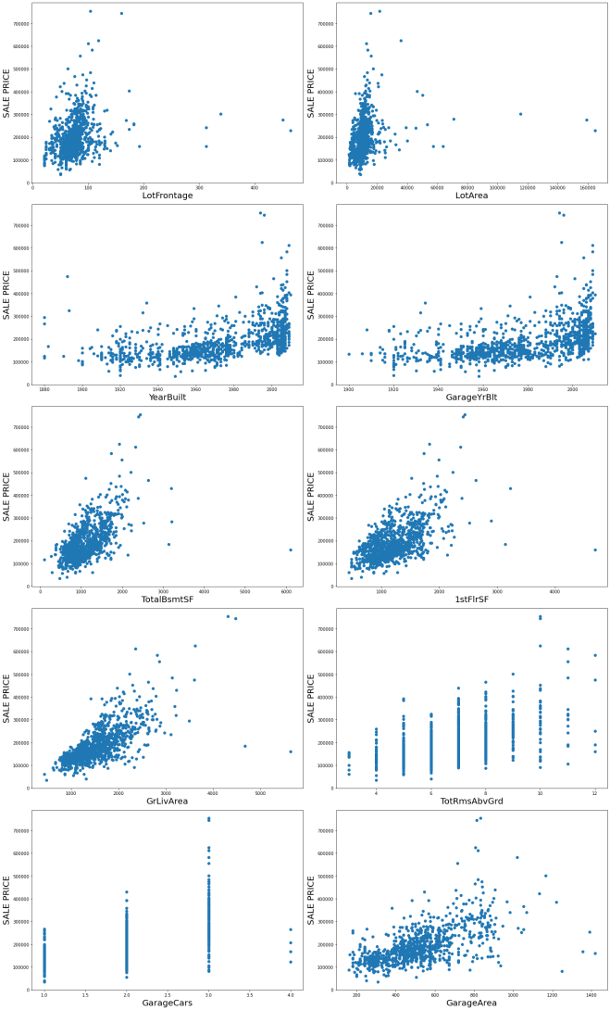
Feature Selection (Scatter Plot)

Slide 26
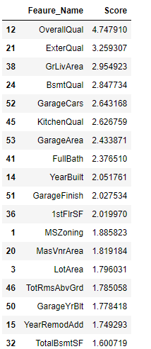
Feature Selection
SelectKBest
X=df.drop(columns=['SalePrice'])
y=df['SalePrice']
#Using SelectKBest feature seleciton Method
from sklearn.feature_selection import SelectKBest,f_classif
best_features=SelectKBest(f_classif, k=64)
fit=best_features.fit(X,y)
df_scores=pd.DataFrame(fit.scores_)
df_columns=pd.DataFrame(X.columns)
#concatenate dataframes
feature_scores = pd.concat([df_columns,df_scores],axis=1)
#name output columns
feature_scores.columns = ['Feaure_Name','Score']
#print 17 best features
top_features = feature_scores.nlargest(64,'Score')
print(feature_scores.nlargest(64,'Score'))

Slide 27
Drop Least Contributing Features
columns_drop=['LotFrontage','GarageYrBlt','TotalBsmtSF','TotRmsAbvGrd','GarageArea','BsmtFinType2','MSSubClass','Exterior2nd']
df.drop(columns=columns_drop,inplace=True)

Slide 28
2. Handling Skewness
Check Skewness of the Continuous Variables
cont_var = ['LotFrontage','LotArea','MasVnrArea','BsmtFinSF1','BsmtFinSF2','BsmtUnfSF','TotalBsmtSF','1stFlrSF','2ndFlrSF','GrLivArea','GarageArea','WoodDeckSF','OpenPorchSF','EnclosedPorch','SalePrice']
Use .describe() method to check the distribution of the continuous variables
df[cont_var].describe()

Slide 29
2. Handling Skewness

Slide 30
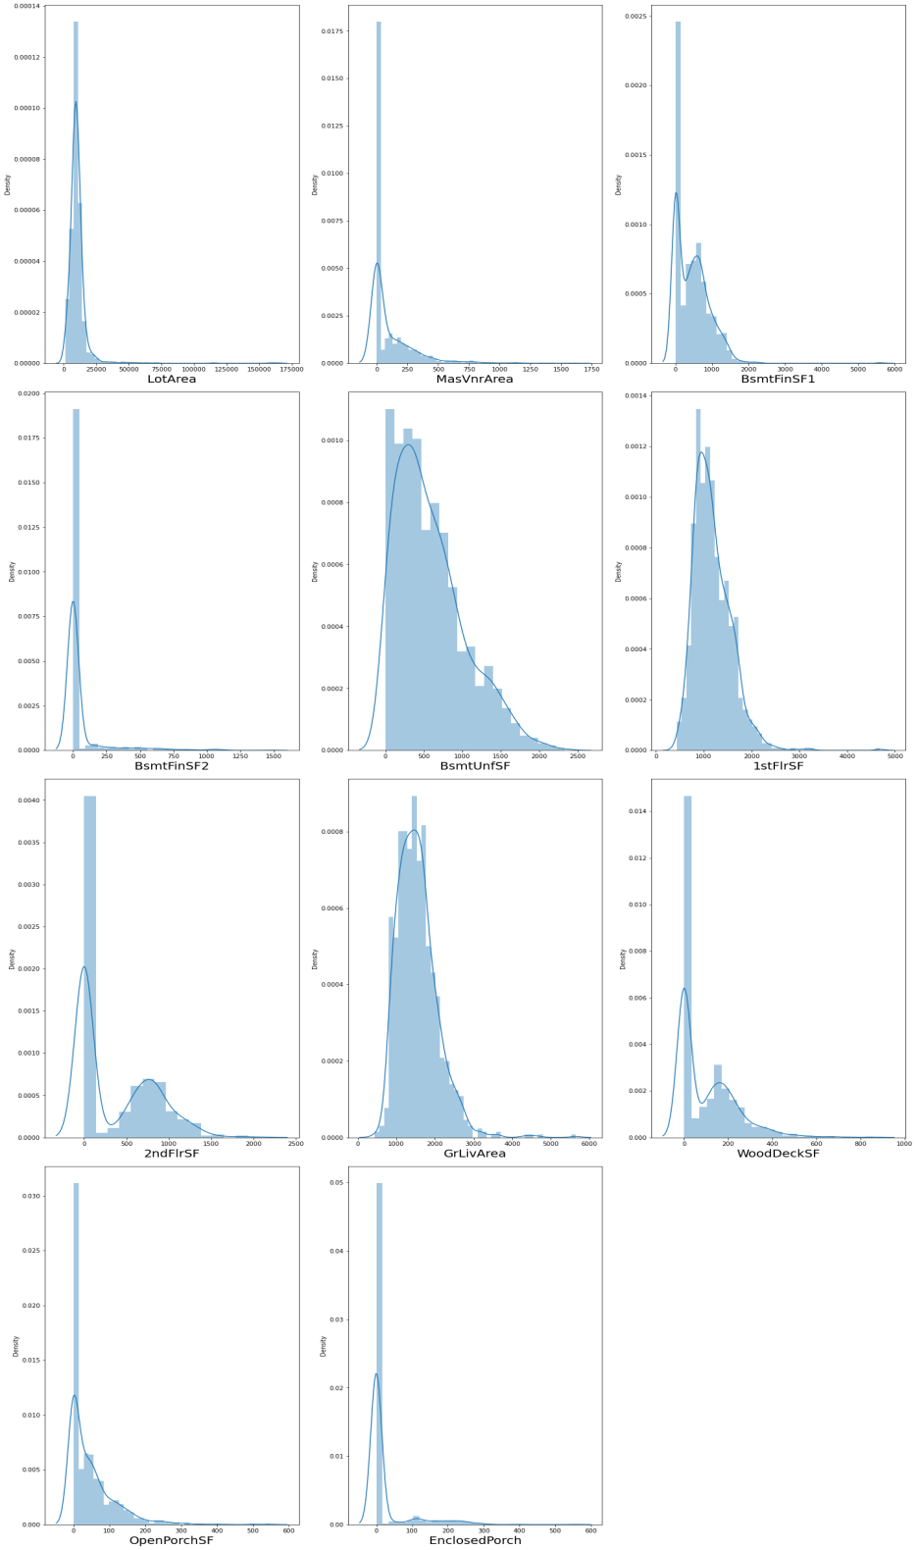
Handling Skewness
Check Skewness of the continuous
features Using Distribution Plot
LotArea = High values of 0,right skewed
MasVnrArea = High values of 0, righ skewed
BsmtFinSF1 = High values of 0, right skewed
BsmtFinSF2 = Very high values of 0, right skewed
BsmtUnfSF = Slightly skewed
1stFlrSF = Slightly Skewed
2ndFlrSF = Very high values of 0, right skewed
GrLivArea = right skewed
WoodDeckSF = Very high values of 0, right skewed
OpenPorchSF = Very high values of 0, right skewed
EnclosedProch = Very high values of 0, right skewed

Slide 31
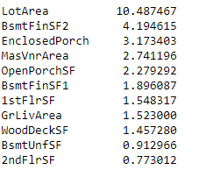
3. Power Transformation
Checking skewness of the features
df[cont_columns].skew().sort_values(ascending=False)

Slide 32
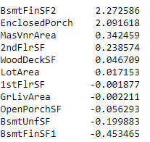
Power Transformation
Applying Powertransformation on the continuous features and checking skewness post transformation
from sklearn.preprocessing import power_transform
df_cont_new = power_transform(df_cont)
df_cont=
pd.DataFrame(df_cont_new,columns=df_cont.columns)
df_cont.skew().sort_values(ascending=False)

Slide 33
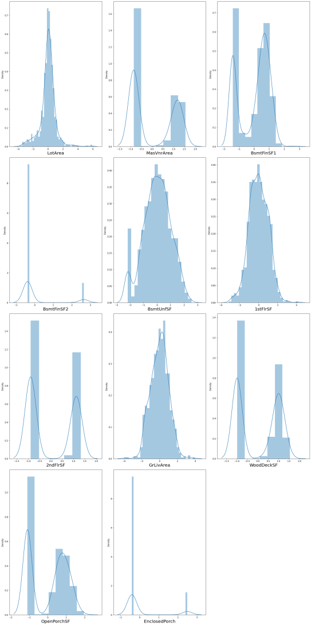
Power Transformation

Slide 34
4. Standard Scaler
Divide into Feature (X) & Label (y)
X=df.drop(columns=['SalePrice'])
y=df['SalePrice']
Data Scaling
scaler = StandardScaler()
X= scaler.fit_transform(X)

Slide 35
(iii) Data Visualization
Distribution Plot
Scatter Plot
Box Plot

Slide 36
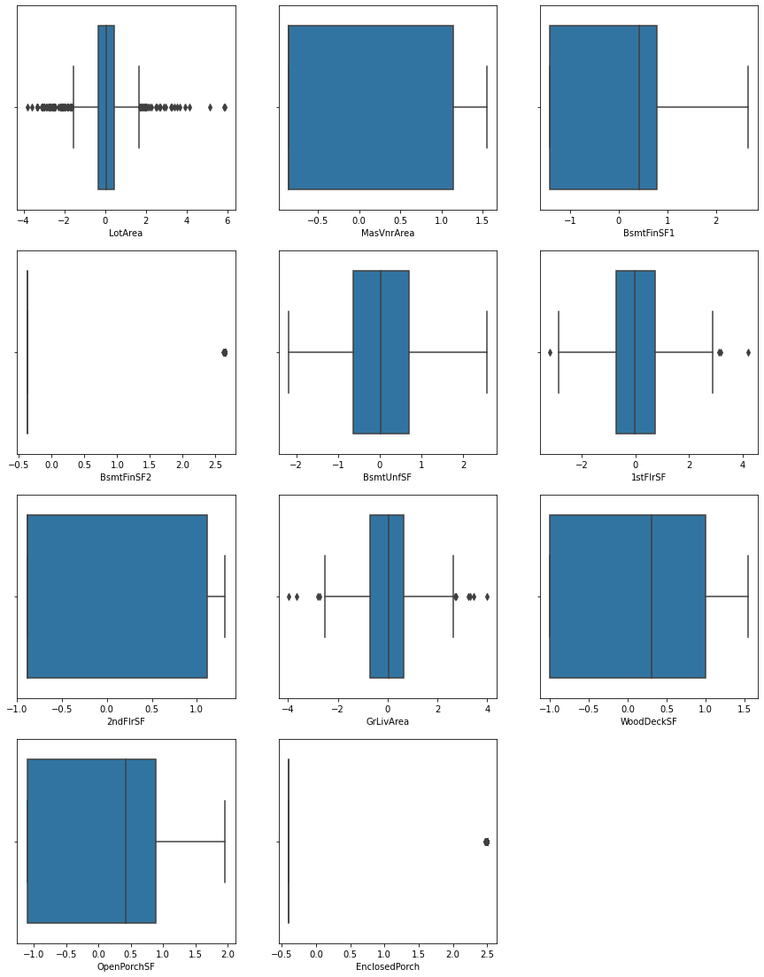
Box Plot
Dist Plot & Scatter Plot
already shown in the previous slides
of feature engineering
LotArea has a lot of outliers in it,
but because this feature describes the
lot size in square feet
there would be many houses with
different lot sizes
and hence we should not drop that data.
That is why,
we will move ahead with our modeling

Slide 37
Important Steps
1. Find Best Random State
2. Train-Test Split
3. Using Regression Models

Slide 38
1. Find Best Random State
#Finding best random_state
from sklearn.linear_model import LinearRegression
lr=LinearRegression()
from sklearn.metrics import r2_score
maxAccu=0 #maximum accuracy
maxRS=0 #best random state value for which max accuracy is acheived
for i in range(0,100):
x_train,x_test,y_train,y_test = train_test_split(X,y,test_size=0.20,random_state=i)
lr.fit(x_train,y_train)
y_pred=lr.predict(x_test)
acc = r2_score(y_test,y_pred)
if acc>maxAccu:
maxAccu=acc
maxRS=i
print("Best accuracy is", maxAccu,"on Random State", maxRS)

Slide 39
2. Train-Test Split
x_train,x_test,y_train,y_test = train_test_split(X,y,test_size=0.30,random_state=3)

Slide 40
3. Using Regression Models
Linear Regressor
Decision Tree Regressor
RandomForest Regressor
AdaBoost Regressor
XGBoost Regressor

Slide 41
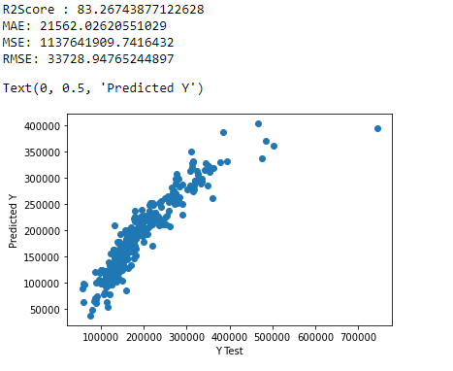
Linear Regressor

Slide 42
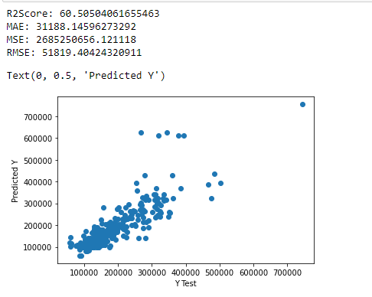
Decision Tree Regressor

Slide 43
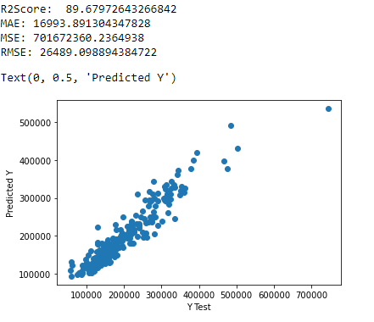
Random Forest Regressor

Slide 44
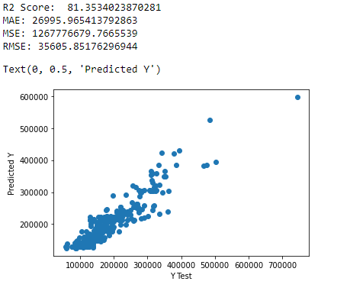
AdaBoost Regressor

Slide 45
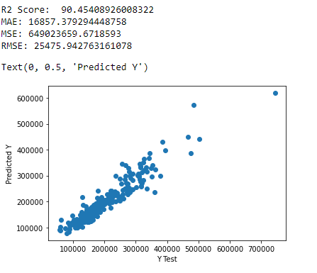
XGBoost Regressor

Slide 46
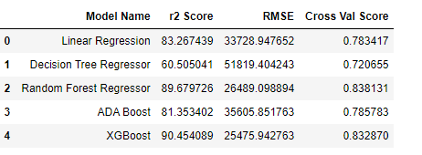
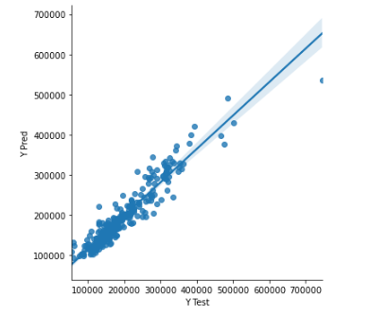
Model Dashboard

Slide 47
Hyper-Parameter Tuning
RANDOM FOREST REGRESSOR
parameters = {'criterion':['mse','mae'], 'max_features':["auto","sqrt","log2"]}
rf = RandomForestRegressor()
clf = GridSearchCV(rf,parameters)
clf.fit(x_train,y_train)
print(clf.best_params_)
rf = RandomForestRegressor(criterion="mae",max_features="sqrt")
rf.fit(x_train,y_train)
rf.score(x_train,y_train)
y_pred=rf.predict(x_test)
rfs = r2_score(y_test,y_pred)
print("r2_score:",rfs*100)
rfscore = cross_val_score(rf,X,y,cv=5)
rfc=rfscore.mean()
print("Cross val score:",rfc*100)
r2_score: 86.67362420217691
Cross val score: 83.95052370523904

Slide 48
Finalized Model
RandomForest Regressor
RF Regressor gives the following r2 score:-
R2score = 89.68
CV Score = 83.81
Hyperparameter tuning = 86.67

Slide 49
Test DataSet
Perform the same EDA & Feature Engineering steps on the test dataset
Predict the target column using the trained Random Forest Regressor
Save the model in a pickle file.

Slide 50
Conclusion
We are able to predict the price of the houses in the test dataset with a model r2score of 86.67% using RandomForest Regressor

